Slide 1
Weekly Poor PDP Case Review
Aug 24 - Sep 6, 2026

Slide 2
Weekly Poor PDP Case Review
Overview | Aug 24 - Sep 6, 2026
Metric | Value
Total Poor Case in last 2 weeks | 77
Total Types of Product | 20
Total Case related to Log Team (%) | 57 (74.0%)
Total Case not related to Log Team (%) | 20 (26.0%)

Slide 3
Weekly Poor PDP Case Review
Problems Pattern | Aug 24 - Sep 6, 2026
Problem | Cases | Products | %
包裝問題 | 34 | 17 | 59.6%
其他 | 17 | 12 | 29.8%
原箱問題 | 3 | 2 | 5.3%
溫度問題 | 2 | 1 | 3.5%
罐裝問題 | 1 | 1 | 1.8%

Slide 4
Weekly Poor PDP Case Review
Comparison of Performance by Districts | Aug 24 - Sep 6, 2026
Rank | District | Cases | Rep. Product (ID + Name) | % of Log Team
1 | NT-TSM | 8 | B1237001_S_vita_water700_24 | 維他純蒸餾水-原箱700毫升 x 24#維他水... | 14.0%
2 | ETX | 7 | H0888001_S_P10020921 | [原箱] 梳打水 330ml x 24 (新舊包裝隨機發送)... | 12.3%
3 | NT-TW | 7 | H0888001_S_10138408C | 鈣思寶高鈣無糖原味豆奶 250毫升6包裝 x 4排 (新舊包... | 12.3%
4 | ETH | 6 | H0888001_S_P10142992 | [原箱] 青檸味有氣水 (新舊包裝隨機發送) | 10.5%
5 | NT-ST | 6 | H0888001_S_10160608 | [優惠套裝] 除臭潔廁泡沬噴裝+補充裝x3 | 10.5%
6 | WTH | 6 | H0888001_S_10008800 | 活性乳酸菌飲品(冷凍) 100毫升 X 5支 | 10.5%
7 | NT-TM | 5 | H0888001_S_10146186 | 賢者之食卓膳食纖維 (阻澱粉 隔油份) #平行進口 [逢週四開... | 8.8%
8 | ETK | 4 | H0888001_S_P10020921 | [原箱] 梳打水 330ml x 24 (新舊包裝隨機發送)... | 7.0%
9 | WTK | 4 | H0888001_S_10008402B | 大阿蘇牛乳 1公升 x 3 | 7.0%
10 | WTX | 4 | H0888001_S_10159143C | [法國直送] K1664 白啤酒巨罐 單罐裝 500ML x... | 7.0%
Total Log Team Cases: 57 | Sum%: 99.9%

Slide 5
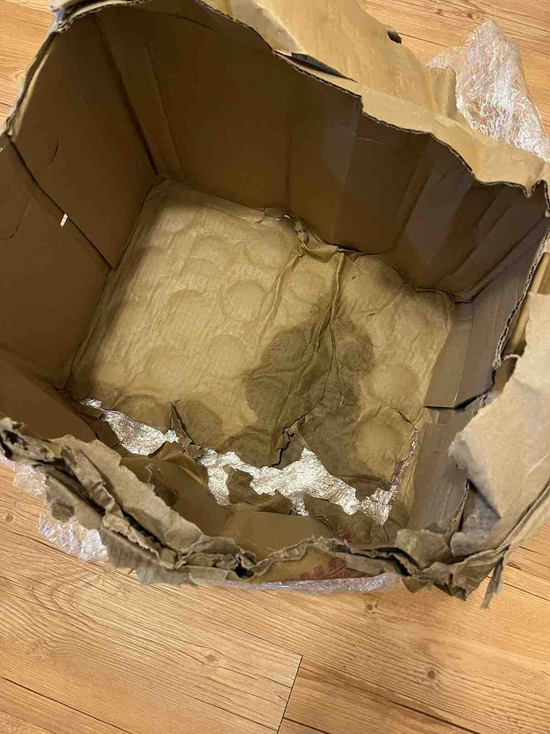
Weekly Poor PDP Case Review
Case Review - 包裝問題 (34 cases in window)
Product ID: B1237001_S_vita_water700_24 | 維他純蒸餾水-原箱700毫升 x 24#維他水#維他蒸餾水#官方正貨#700水
District: ETH
Shipping Warehouse: 將軍澳倉
Pickpack Warehouse: Merchant貨
Order: H260826513518 | Waybill: 8147422033
Checking Result: 因天雨關係紙皮箱會因濕水變軟損壞及發臭
膠紙封住全箱，剪開膠紙後，一陣惡臭/ 腐臭味傳出。而且紙箱毀壞/ 穿底，飲品的包裝，非常不衛生/ 不合格。
1/2

Slide 6
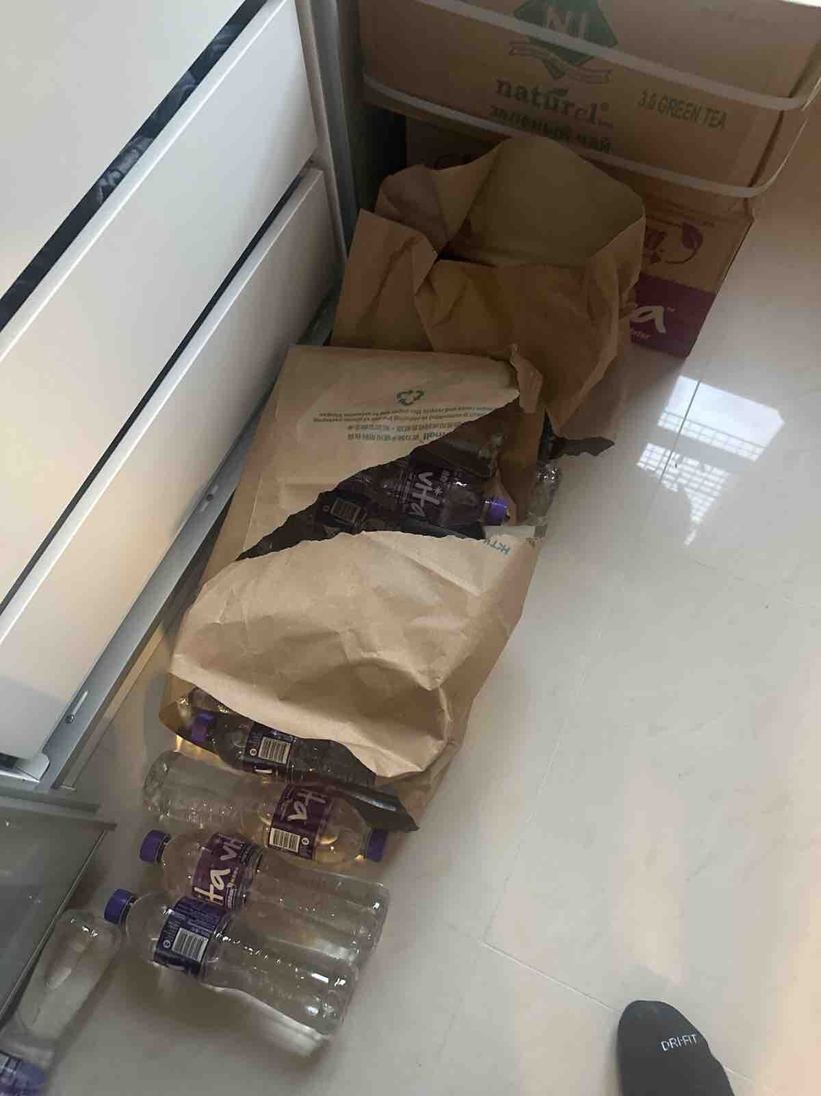
Weekly Poor PDP Case Review
Case Review - 包裝問題 (34 cases in window)
Product ID: B1237001_S_vita_water700_24 | 維他純蒸餾水-原箱700毫升 x 24#維他水#維他蒸餾水#官方正貨#700水
District: NT-TSM
Shipping Warehouse: 上水倉
Pickpack Warehouse: Merchant貨
Order: H260904533530 | Waybill: 8165541184
Checking Result: 原箱水紙箱較容易爛
買四箱水有兩箱得返紙袋，我點樣去存放啲水，仲要啲紙袋全部都係爛晒。
2/2

Slide 7
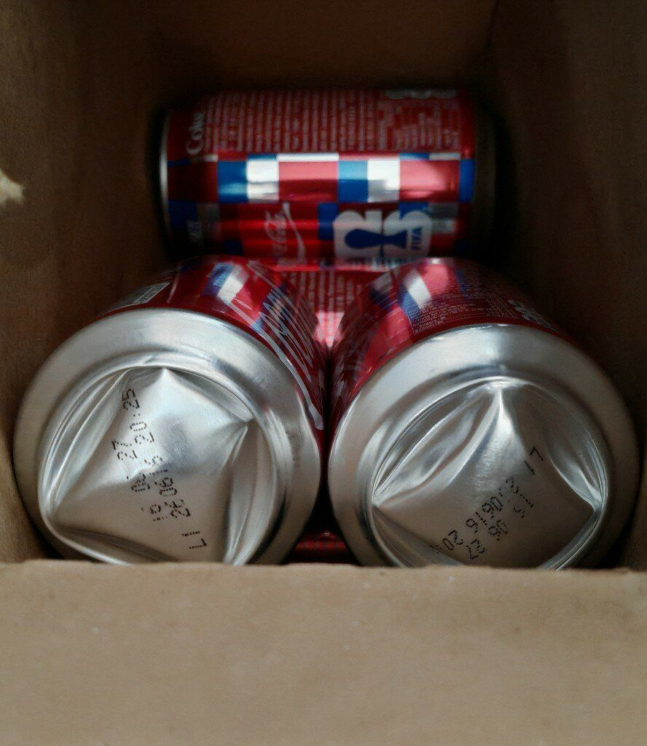
Weekly Poor PDP Case Review
Case Review - 其他 (17 cases in window)
Product ID: H0888001_S_10022674 | 可口可樂330毫升X12罐 (新舊包裝隨機發送)
District: WTK
Shipping Warehouse: 青衣倉
Pickpack Warehouse: Warehouse貨
Order: H260828533435 | Waybill: 8151562228-2
打開盒子拿出來，已經是這個狀態！
1/2

Slide 8
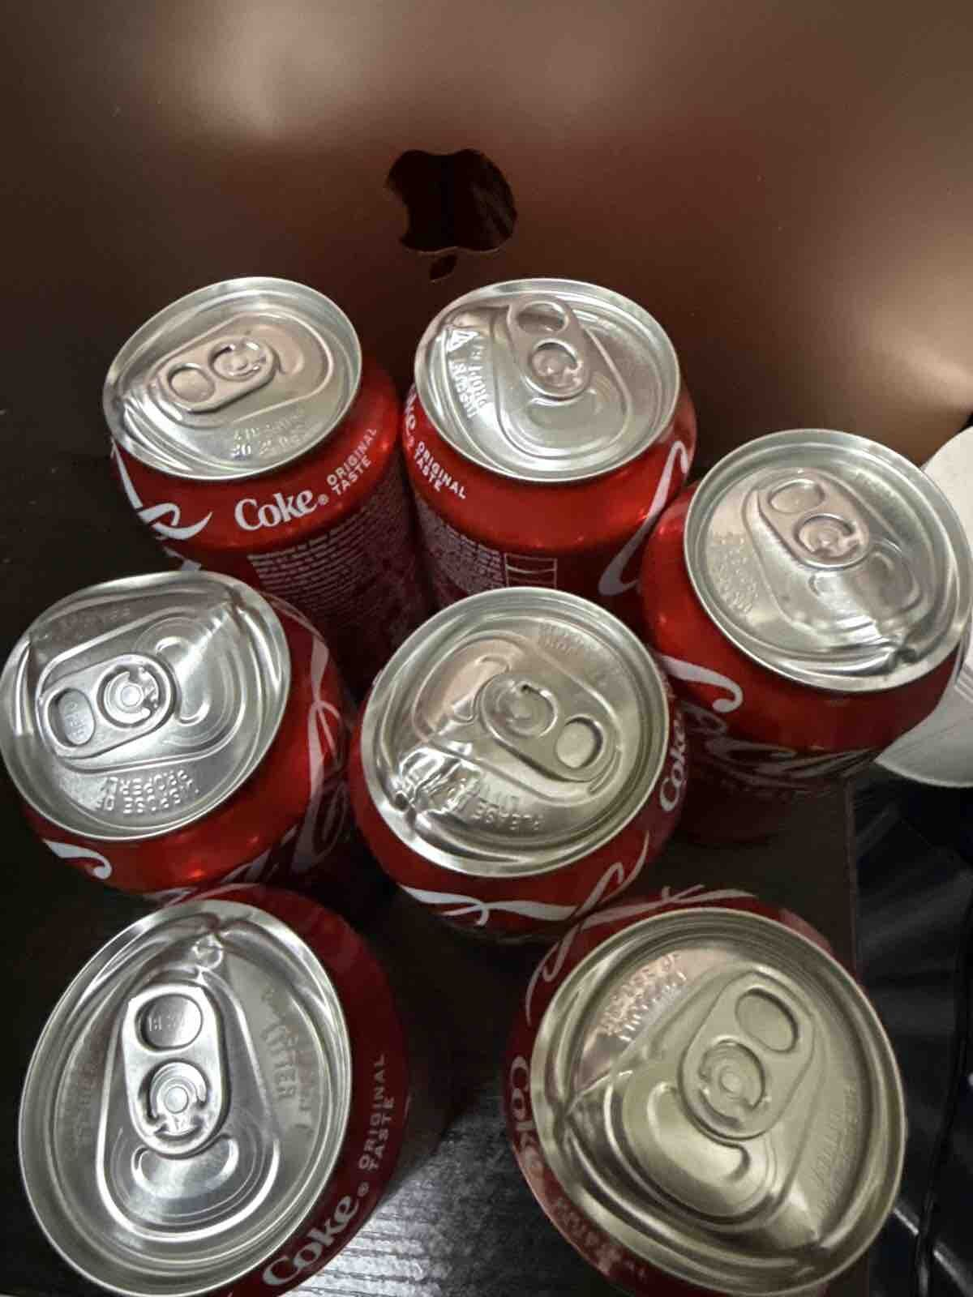
Weekly Poor PDP Case Review
Case Review - 其他 (17 cases in window)
Product ID: H0888001_S_10022674 | 可口可樂330毫升X12罐 (新舊包裝隨機發送)
District: WTX
Shipping Warehouse: 青衣倉
Pickpack Warehouse: Warehouse貨
Order: H260828504868 | Waybill: 8150383698-1
Checking Result: 凸罐係儲存問題,非物流問題
訂12罐，7罐送到黎都係咁變曬形，一開都流啦
完全無包裝過就咁送貨，真係完全唔得囉
變一兩罐都算數，7罐都係咁仲多過一半呀
2/2

Slide 9
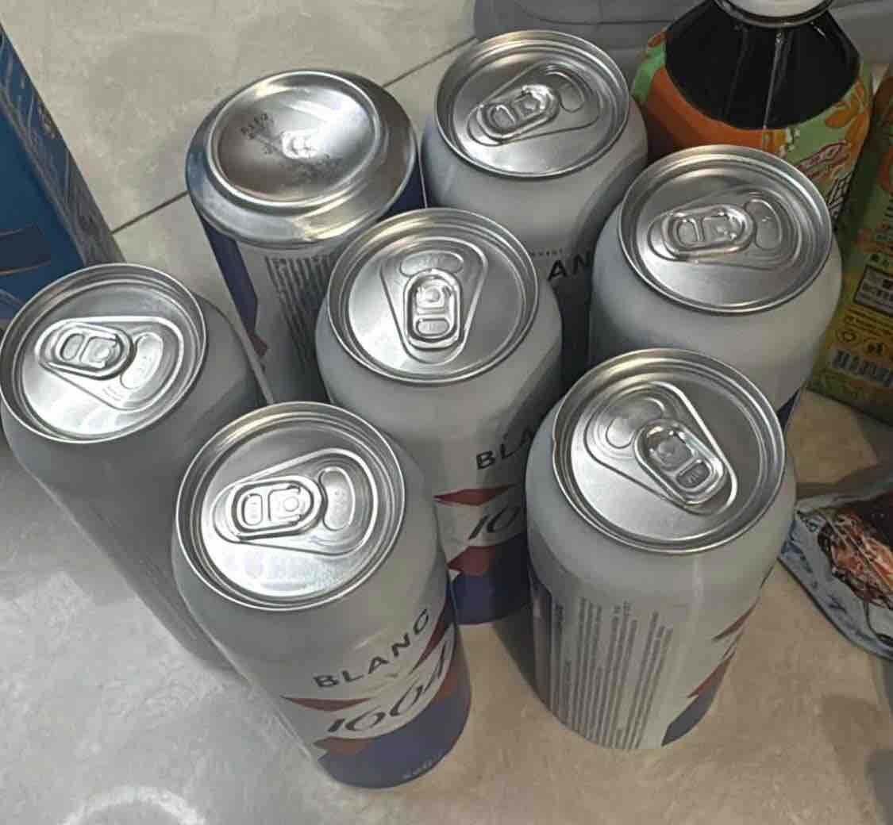
Weekly Poor PDP Case Review
Case Review - 原箱問題 (3 cases in window)
Product ID: H0888001_S_10159143C | [法國直送] K1664 白啤酒巨罐 單罐裝 500ML x 4 [逢週四開搶，限購兩件]
District: ETK
Shipping Warehouse: 將軍澳倉
Pickpack Warehouse: Warehouse貨
Order: H260829506828 | Waybill: 8158311470-1
Checking Result: 欠貨問題, 不是車隊出錯
買兩set即係八罐，只收到散裝七罐。
1/2

Slide 10
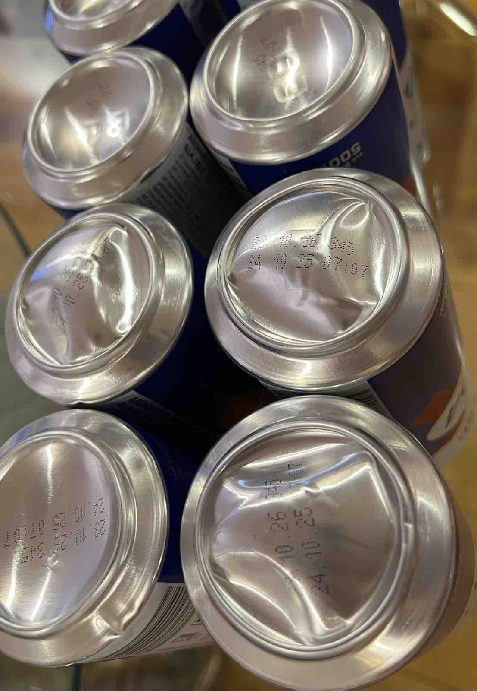
Weekly Poor PDP Case Review
Case Review - 原箱問題 (3 cases in window)
Product ID: H0888001_S_10159143C | [法國直送] K1664 白啤酒巨罐 單罐裝 500ML x 4 [逢週四開搶，限購兩件]
District: WTX
Shipping Warehouse: 青衣倉
Pickpack Warehouse: Warehouse貨
Order: H260902502714 | Waybill: 8160839447-3
Checking Result: 凸罐係儲存問題,非物流問題
1.包裝欠佳：送貨員送遞是散裝一罐罐散修修遞俾我嘅 我買咗8罐, 係咪起碼都攞個紙袋或紙盒入住先呢？
2.外觀損毁：8罐裏面 有1罐凹咗, 有3罐底部凸晒出嚟 唔會企得穩.
3.建議食用日期: 今日2026年9月，到期日係10月23. 即係得一個月時間左右.
2/2

Slide 11
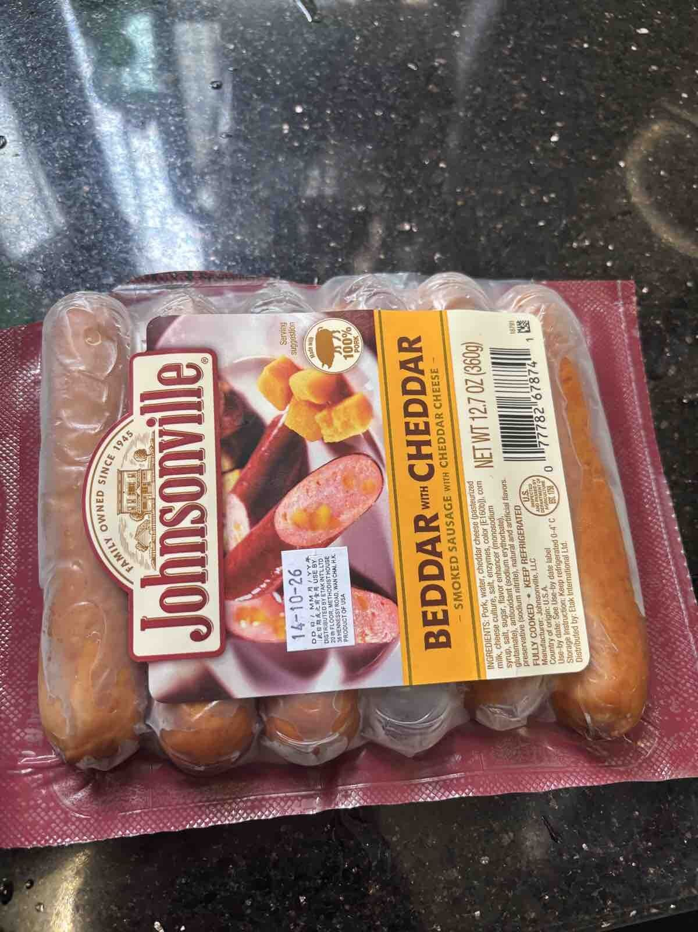
Weekly Poor PDP Case Review
Case Review - 溫度問題 (2 cases in window)
Product ID: H0888001_S_40000160 | [官方行貨] 煙燻車打芝士香腸 #冷凍0-4°C
District: NT-TM
Shipping Warehouse: 屯門倉
Pickpack Warehouse: Warehouse貨
Order: H260830552576 | Waybill: 8157428752-1
Checking Result: 應該貨品品質問題
冷藏平均: 5.27 | 急凍平均: -12.12 | 冷藏最低: 1.8 | 急凍最低: -19.8
收貨即入雪櫃，今朝煮黎食又臭又酸，失望到爆炸。。要求退款😔

Slide 12
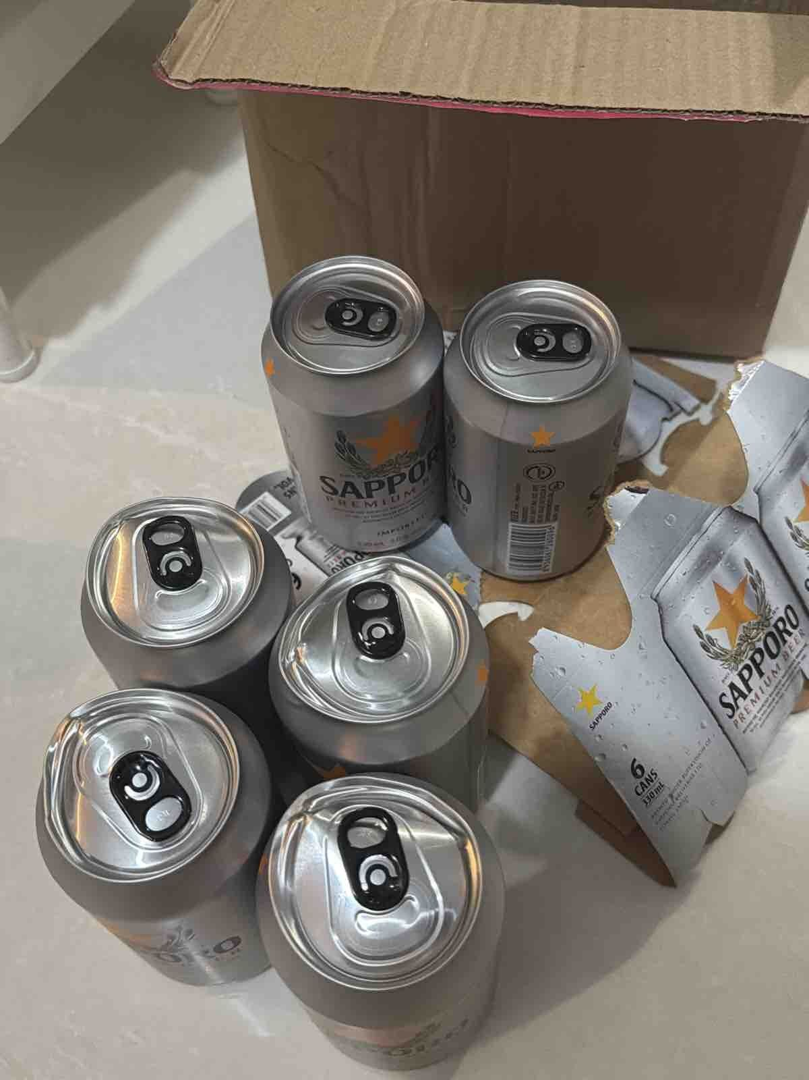
Weekly Poor PDP Case Review
Case Review - 罐裝問題 (1 cases in window)
Product ID: H7712001_S_nb21x6 | [6罐]七寶啤酒 (細罐裝) 330ml x 6（新舊包裝隨機發送 #札幌啤酒
District: ETX
Shipping Warehouse: 觀塘倉
Pickpack Warehouse: Merchant貨
Order: H260828503044 | Waybill: 8150304071
Checking Result: 凸罐係儲存溫度既問題
六罐啤酒有四罐都凹凹凸凸，品質欠佳

